Slide 1
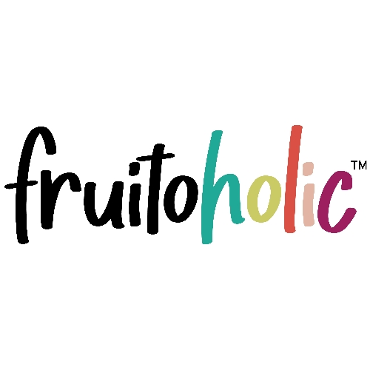
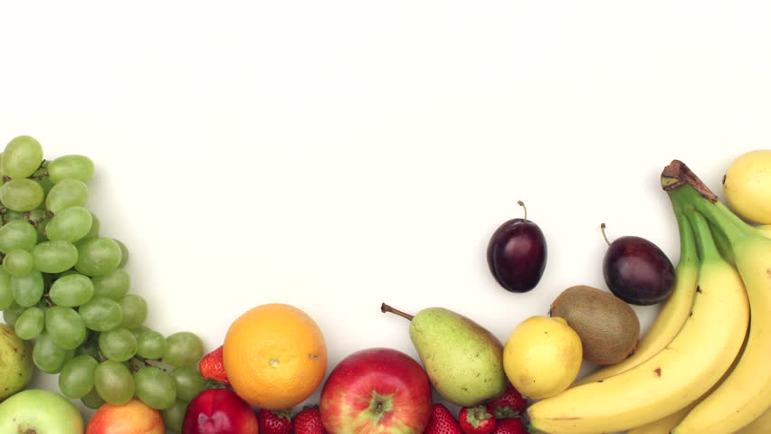

Fruitoholic
Case Study Competition
Team Aspirants
Akash Gupta, SCMHRD, Pune
Devesh Sinha, TAPMI, Manipal
Rajvi Sheth, SCMHRD, Pune

Slide 2


Research
Target Customers
Solutions
Product
Go To Market
Market Expansion
Market Research
Primary Research
127 respondents.
Hyderabad accounts for a majority of the responses.
51% respondents buy fruits 4 times/month.
70% respondents are unaware of WHO recommendation.
About 57% respondents are confident that a subscription model would benefit them.
96% respondents consume inadequate amount of fruits.

Slide 3
Research
Target Customers
Solutions
Product
Go To Market
Market Expansion
Secondary Research
Primary Research
87.4% of respondents feel the need for organic fruits.
Lifestyle issues, high cost and seasonal availability are the major reasons for having fruit consumption less than recommended levels.
Approximately 50% respondents are willing to spend Rs 2000- Rs 4000 per month and 34 % respondents are willing to spend less than Rs 2000 per month on fruits.
For Fitness enthusiasts:
Avocados- Help in building protein.
Kiwi- Fat burning effect.
Banana-Stop muscle breakdown,, source of potassium and electrolytes that help in proper muscle contraction.
Watermelon- provides nitric oxide that allows blood flow to reach the muscles, also provide hydration.
Pear, grapes, watermelon, apple- Best pre-workout choices.
Peach apple, grapes- Best post-workout choices.
Grapefruit, apple, orange, watermelon- Best supplements.
Dates, tamarind, almonds- Sources of instant energy.
For Working professionals:
Bananas- provide energy, rich in potassium that is essential for muscles, nerves and blood vessels.
Apple- Builds immunity.
Oranges, grapes, kiwi- Rich in Vitamin C, helps build immunity.
Watermelon- Rich in water, has a hydrating effect.
Papaya and muskmelon- Rich in Vitamin A, also boosts metabolism.
Pomegranate- Rich in iron and minerals.
For Detoxification needs:
Bananas- Rich in potassium and electrolytes, help to rebuild damaged tissues.
Kiwi-Rich in Vitamins and minerals, ideal for detoxification.
Oranges and grapes-Help in healing of damaged body tissue.
Watermelon- Hydrating effect which assists with removal of toxic substances from the body.
Papaya and apples- Improve metabolism, immunity and overall body health.
For People with Ailments:
Bananas- Healthiest form of sugar
Grapefruit, Orange, Sweet lime- Rich in Vitamin C, Help to improve immunity
Guava and Avocado- Improves skin and hair
Muskmelon and Papaya- Improve metabolism.
Apple and Pear- Improve overall body health and health of digestive organs.
Pomegranate- Rich in iron and minerals.
.
Fruit Requirements of our Major Consumers

Slide 4
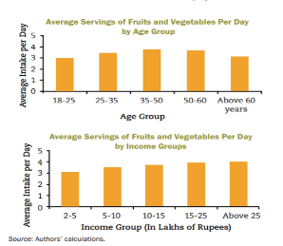



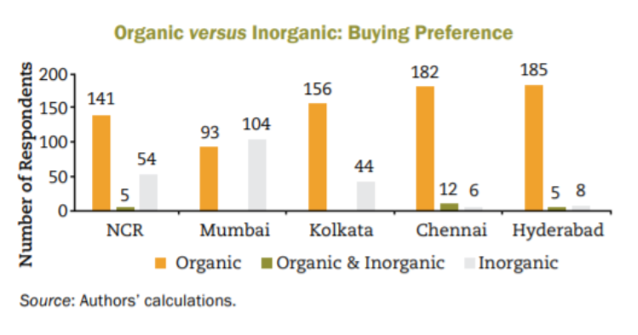
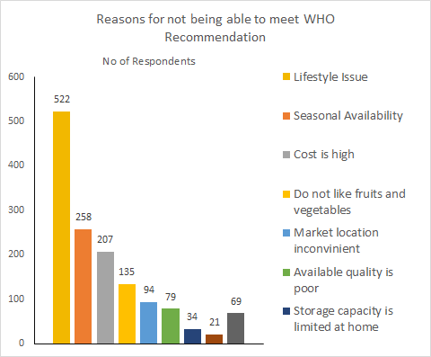
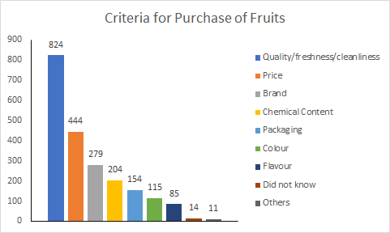

Research
Target Customers
Solutions
Product
Go To Market
Market Expansion
Market Research
Secondary Research
A majority of Indian consumers (75.6 per cent) are willing to purchase organic products as they consider them to be of better quality and free of pesticides and chemicals. However, only 29 % of the respondents actually buy organic products.
The gap between the willingness to buy and actual purchase is due to non-availability of organic fruits.
A majority (56 per cent) of the respondents are willing to purchase non-branded fruits and vegetables as they feel that branded products are over-priced, contain preservatives and are not always fresh and chemical free.
Conducted by icrier.org
(Stratified Sampling of 1,001 Respondents)
Regions Covered:
NCR (New Delhi, Delhi, Gurgaon, Noida, Haryana, UP)
Mumbai (Maharashtra)
Chennai (Tamil Nadu)
Hyderabad (Telangana)
Kolkata (West Bengal)
Age Group- 18 Years and Above
58%
42%
Average Intake
1.5 serving/day(80gm/day)
Average daily intake
Higher for high income groups
89% respondents
Not aware of WHO recommendation

Slide 5





Research
Target Customers
Solutions
Product
Go To Market
Market Expansion
Consumer Persona | Identity | Consumer’s Needs | Fruitoholic’s Position
 | Fitness Enthusiasts!! | Diet Plan with vitamins, protein and other nutrients. | A Perfect Subscription based Diet Plan to keep you Fit!!
 | Diabetic/Hypertensive or other Ailments. | Diet rich in nutrients to increase metabolism to fight ailments and build immunity. | Fight ailments better with Subscription Based Fruit Diet Chart for each Ailment.
 | Working Professionals too busy to take care of their health !! | A helping Hand to buy right fruits in order to stay healthy and focused! | Fruits according to diet plan to reach you along with your Breakfast and Lunch Boxes.
 | Addicted Person wanting a natural Detoxification! | Detoxifying Fruit Diet Chart for proper hydration and rich in vitamin C! | Subscription Based monthly Diet Plans to help you detox and quit your addiction!
 | The Regular Guy! | WHO Recommended Fruit Consumption and hassle free purchase of quality fruits! | Subscribe with one click to our Customized Plan as per your taste and needs! Sit Back and relax !

Slide 6
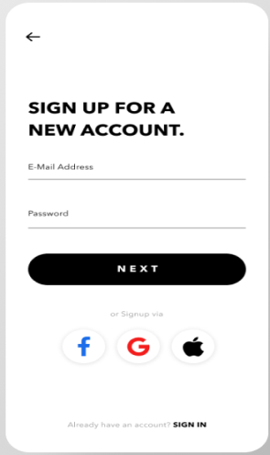







Research
Target Customers
Solutions
Product
Go To Market
Market Expansion
Partnership Model
Health/Fitness Clubs
Lunch Box Services
Detoxification Centers
Cinema Halls/
Auditoriums
Societies with High Target Consumer Occupancy.
Fruitoholic App
The Fruitoholic App Launch in Hyderabad
Choose and order from varied range of fresh fruits, Fruit Juice, Smoothies, Fruit Salads with just a click.
Makes it easy for Customers to understand about and Subscribe a Relevant Plan.
Customers can add fruits as per their choice and choose a customized subscription plan.
Customers can keep a track on the location & delivery of their fruits.
Strategic Partnership Example
Subscription Plan
Hyderguda Main Rd, Himayatnagar, Hyderabad, Telangana
A monthly Subscription Plan makes Fruitoholic a one stop solution for all the Consumer ’s Needs!
Our Research shows that Lack of time to buy fruits is one of the major reasons for low fruit consumption!
High Cost of fruits makes it unaffordable for consumers!
More than 90% Respondents believe that a subscription model for fruits will benefit them!
Fruitoholic Seminar/Webinar on importance of fruits for fitness and present our Product lines & Subscription model
Number of Customers | 500
Conversion Factor | 10%
Subscription Price | ₹ 2500
Total Revenue in 1st month(estimated) | ₹ 125000
Partnership Share to Gold’s Gym(20%) | ₹ 25000
Fruitoholic’s Share | ₹ 100000

Slide 7
Research
Target Customers
Solutions
Product
Go To Market
Market Expansion
Our Sample Subscription Plans
Product Catalogue available on The Fruitoholic App and Website
Customized subscription plan also available.
Subscribed fruits to be delivered in weekly batches.
Fitness Enthusiast
Working Professional
Detoxification
Ailments
₹ 2499/month
₹ 1499/month
₹ 1599/month
₹ 1799/month
4kg Robusta bananas
2kg Grapefruit
2kg Kiwi/Valencia orange/sweet lime/pear
2kg Watermelon
1.5kg Muskmelon/ Pineapple/Papaya
500gm Dates/Tamarind/Green Almond
2kg Mandarin orange/Washington Apple/Seedless grapes
2kg Green apple/Avocado
4kg Robusta bananas
2kg Grapefruit/Golden Kiwi/Avocado.
2kg Valencia orange
2 kg Watermelon
1.5kg Muskmelon/ Pineapple/Papaya.
500gm Seedless Grapes
2kg Royal Apple
1kg Pomegranate
4kg Robusta bananas
1kg Kiwi
2kg Valencia Orange
2kg Watermelon
1.5 kg Papaya
1.5 kg Pineapple
2kg Royal Apple
500gm Red Grapes
1kg Small Bananas
1kg Grapefruit/Avocado
2kg Valencia Orange/Thai Jumbo Guava
1.5kg Muskmelon/Papaya
2kg Washington Apple
2kg Royal Apple
1kg Pear/Sweet Lime/Pomegranate
Farmery has introduced a subscription based model in Delhi NCR which has increased their revenue to $5 million.
FruitBox and Co.( an app based model) was launched in 2018, with an investment of just Rs 10 lakh is now raking in Rs 1.25 lakh in daily revenue.
Similar strategies which succeeded!

Slide 8
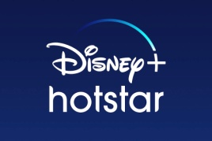




Research
Target Customers
Solutions
Product
Go To Market
Market Expansion
Promotional Strategy
Areas of Concern | Solutions (All Ads to be displayed only in Hyderabad) | Costs to be incurred(in Rs)
No Visibility on Google Search(SEO/SEM) | SEM Google Search 500 CPC Clicks Content Marketing for better SEO Results | 11,800
No Visibility on YouTube | YouTube Ad 40000 Views of Non-Skippable(up to 15 secs) Videos. | 11,800
Low Reach on Facebook Page 620 Followers On an Avg. 4-6 Likes on each post. | Facebook Ad 2500 CPC Banner Units 250000 CPM Banner Units Substantiation by experts needed in awareness posts on the Facebook Page. | 11,800 14,750
Low Reach on Instagram Page 563 Followers 172 posts On an Avg. 30-40 Likes on Each post On an Avg. 150 Views on reels. | Instagram Ad 2500 CPC Banner Units 50000 CPM Views on Instagram Reels More Content on Benefits of fruit in specific Areas should be added on Instagram Page of Fruitoholic. | 11,800 8,850
No Visibility on LinkedIn Page | Dedicated Fruitoholic LinkedIn Page to be created. Relevant Content to be uploaded. LinkedIn Ads 200 CPC Banner Units 20000 CPV Video Ads | 14,160 18,880
Targeted 1 Lakh- CPCV -Mid-Roll- 20 sec Videos Units.
Cost- ₹ 21,240
Targeted 20000 CPC Banner Units.
Cost- ₹ 11,800
Total Estimated Expenditure: ₹1,22,720
Promotional Ad Content:
Consumer Persona Specific Banners on our Offerings in terms of Subscription Plans as one spot solution.
Video Ads to contain Consumer Persona needs and Our Solution through Subscription Plans and other individual products.
End 5 Secs to be allotted for creating awareness on importance of fruits for targeted Consumer Personas.

Slide 9



















Research
Target Customers
Solutions
Product
Go To Market
Market Expansion
Strategic Partnerships
Potential Partners in Hyderabad
Fitness Centers
Create Awareness on relevant benefits of fruits through Seminars/Webinars.
Promotion of Fruitoholic Products and Subscription plans through Banners in gym area.
Lunch Box Services
Use Fruitoholic Ads on Lunchbox carrying vehicles to gain attention.
Use Lunch Box Services to circulate Pamphlets on Fruitoholic products to their Consumers.
Society/Apartment Complexes
Create Awareness on relevant benefits of fruits through Seminars/Webinars.
Provide Discounted Rates for bulk Subscriptions
Provide Products at discounted price for subscription orders in bulk.
Give Discounts on Bulk Subscription Model for Consumers of the Lunchbox Services Chain.
Put up Promotion banners on Fruitoholic products and subscription Plans in the Common Areas.
Cinema Theatres/Auditoriums
Target Cinema halls/ Auditoriums to put up banners of Fruitoholic.
Tie Up with them to sell our products over the counter.(Retail Model)
Use the Big Screen to Advertise Fruitoholic and call for action at intervals.
Detoxification Centers
Put Up banners showing the importance of fruits in detoxification process.
Put up banners showcasing our hassle free subscription plans and products.

Slide 10

Research
Target Customers
Solutions
Product
Go To Market
Market Expansion
Market Expansion Plan :
Market Expansion
Our findings:
State Wise Highest Producers of fruits:
Andhra Pradesh(16.9%)
Maharashtra(15.6%)
Tamil Nadu (11.1%)
Fruit consumption is low ,not due to low production, but due to mismanagement at subsequent levels. Because of the inherent perishable nature /short shelf life of the fruits, as much as 30-35% of fruits perish during harvest, storage, grading, transport, packaging and distribution.
Conclusion:
The distance between production and consumption must be optimized.
An ideal market for fruit consumption would be a place close to the production centre.
Survey results indicate that Chennai would be the next ideal market to expand into due to it’s proximity to production centers and the highest demand for organic fruit products.
Proposed new market : Chennai

